Slide 1
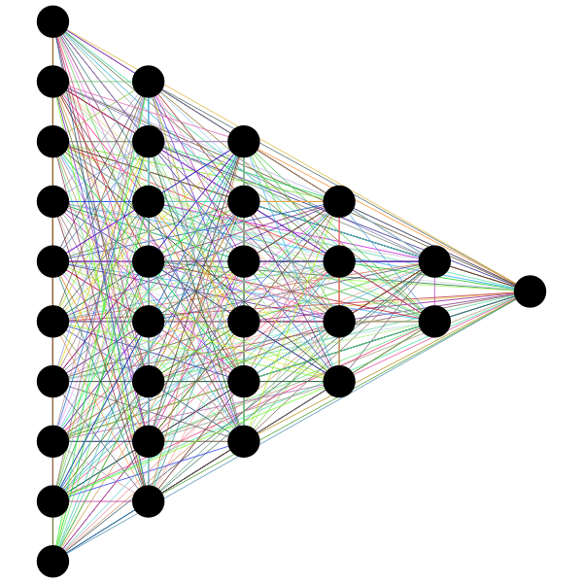
Spotify Music
Data Exploration with Machine Learning
Jerrica Raemer
Julia Olson
Brent Lang

Slide 2
Data Set
Information about music listened to over the course of 1 year
Data set comes from Kaggle and was scraped from Spotify
Music selection of a single person

Slide 3
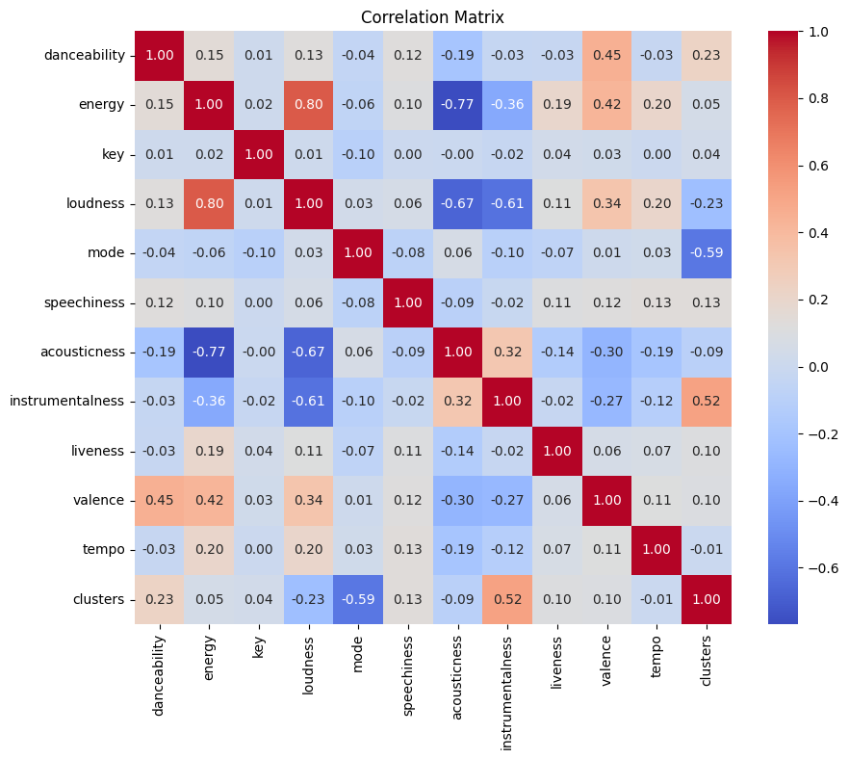
Notes:
Wanted to reduce the number of features, because after doing PCA, we found the amount of variance explained was really low. Looked for different ways to increase that variance, and found that only including features that correlate was a viable technique. Thus, we narrowed it down used correlation matrix to find the most important features. Found that 'energy','acousticness','loudness','instrumentalness'.

Slide 4
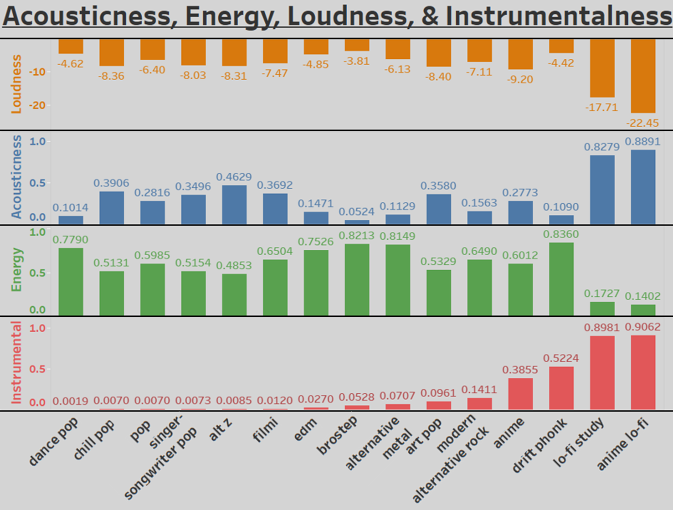

Slide 5
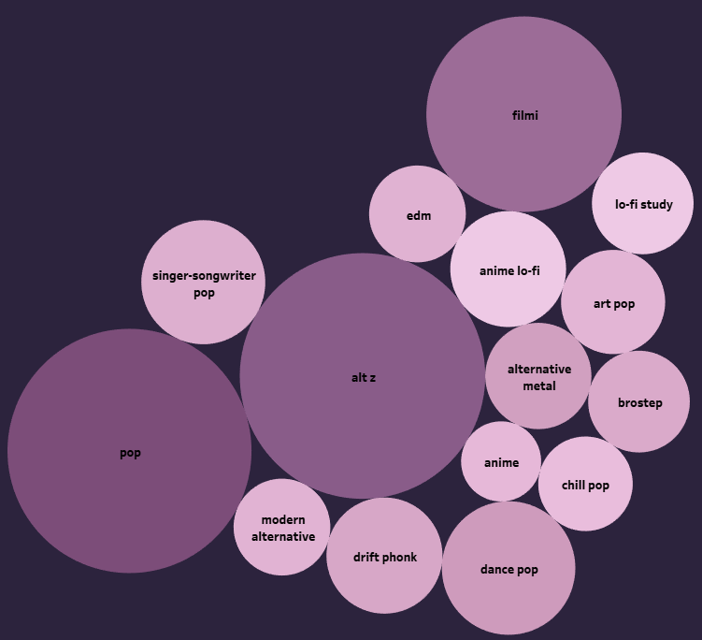
Dance & Energy

Slide 6
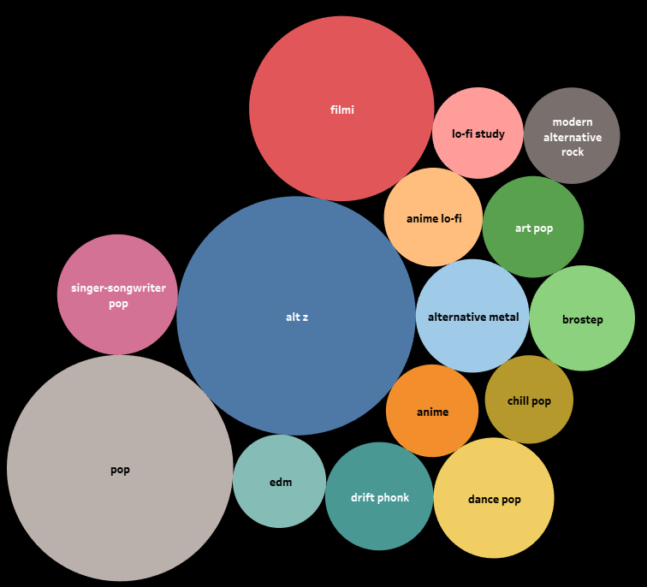
Tempo

Slide 7
Goal
Analyze the music choices of a Spotify user using Unsupervised Machine Learning
Use K-Means and PCA to cluster and visualize the data

Slide 8
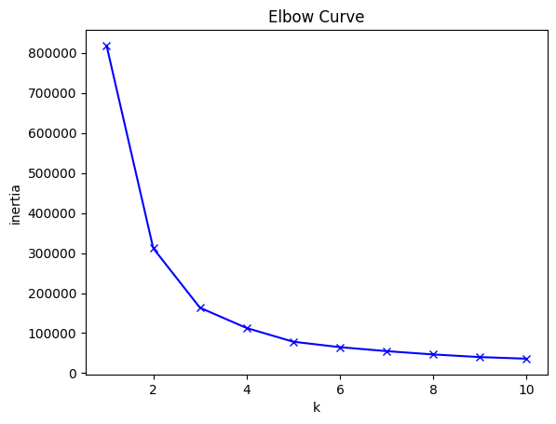
Model Choice
Unsupervised Learning using K-Means Clustering
Stripped out ‘trackName’, ‘artistName’, ‘id’, and ‘time signature’ columns
Elbow curve shows how many clusters we should use:
Elbow curve starts to flatten after 3.

Slide 9
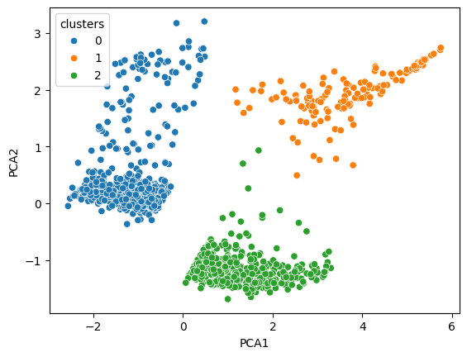
Clusters
We decided to make use of the Standard Scaler to scale the data and Principal Component Analysis (PCA) to reduce the dimensionality
Used PCA to narrow it down to two columns
90% variance explained
Silhouette score: 0.54
Our clusters are shown here:
We have 3 fairly distinct clusters.
Notes:
PCA1: energy, loudness, acoustiness
PCA2: instrumentalness

Slide 10
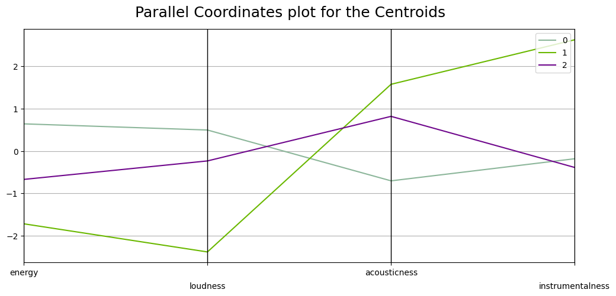
Clusters and Components
Notes:
Cluster 1: energy, loudness, instrumentalness, acoustiness.
Cluster 2: instrumentallness, acoustiness, energy, loudness.
Cluster 3: ecoustiness, loudness, instrumentalness, energy.

Slide 11
Future Considerations
We toyed with creating a recommender system
Turned out to be too complicated

Slide 12
Sources
Kaggle
Pandas
Matplotlib
Tableau
Spotify

